Slide 1
Review
sorting – the process of arranging a collection of items such that each item and its successor satisfy a prescribed relationship.
  sort key – values on which items are ordered.
  items arranged in ascending or descending order.

Slide 2
Merge Sort
Uses a divide and conquer strategy to sort the keys stored in a sequence.
  Keys are recursively divided into smaller and smaller subsequences.
  Subsequences are merged back together.

Slide 3
Merging Sorted Lists
Sometimes it may be necessary to merge two sorted lists into a new list.
  For example
  creates a new merged list
listA = [ 2, 8, 15, 23, 37 ]
listB = [ 4, 6, 15, 20 ]
newList = mergeSortedLists( listA, listB )
print( newList )
[2, 4, 6, 8, 15, 15, 20, 23, 37]

Slide 4
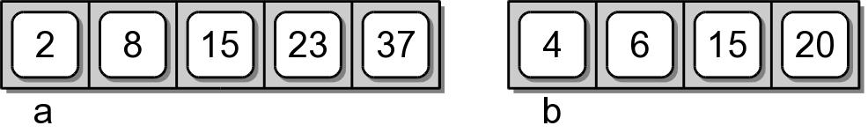
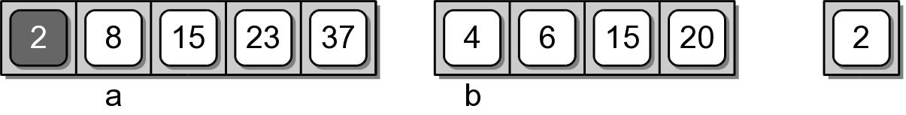
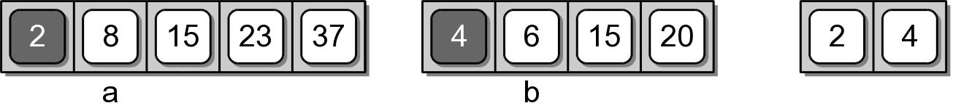
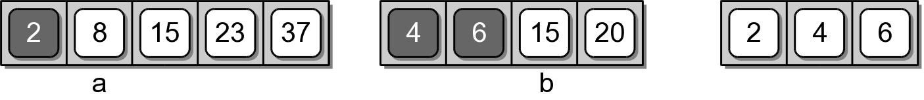
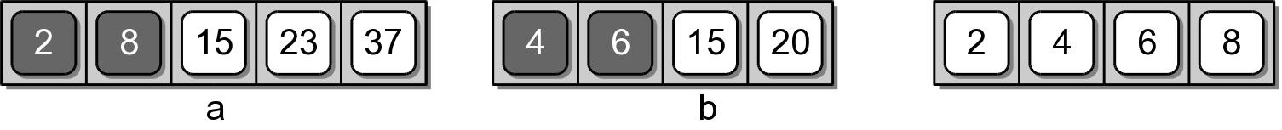
Merging Example

Slide 5
Merging Example

Slide 6
Merging Implementation
def mergeSortedLists( listA, listB ) :
newList = list()
a = 0
b = 0
while a < len( listA ) and b < len( listB ) :
if listA[a] < listB[b] :
newList.append( listA[a] )
a += 1
else :
newList.append( listB[b] )
b += 1
while a < len( listA ) :
newList.append( listA[a] )
a += 1
while b < len( listB ) :
newList.append( listB[b] )
b += 1
return newList

Slide 7
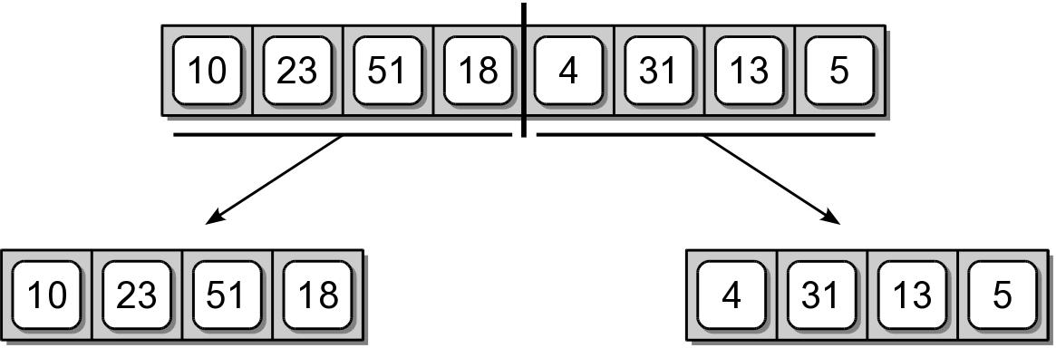
Merge Sort – Divide
Starts by splitting the original sequence in the middle to create two subsequences of approximately equal size.

Slide 8
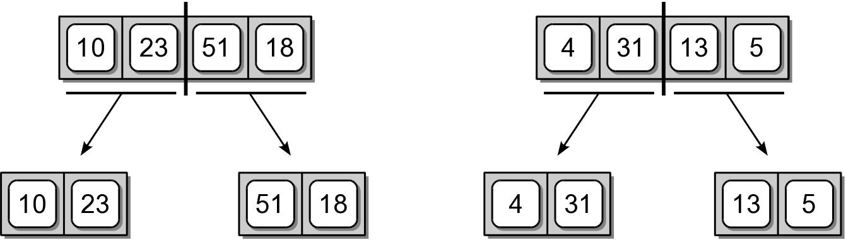
Merge Sort – Divide
The two subsequences are then split in the middle.

Slide 9
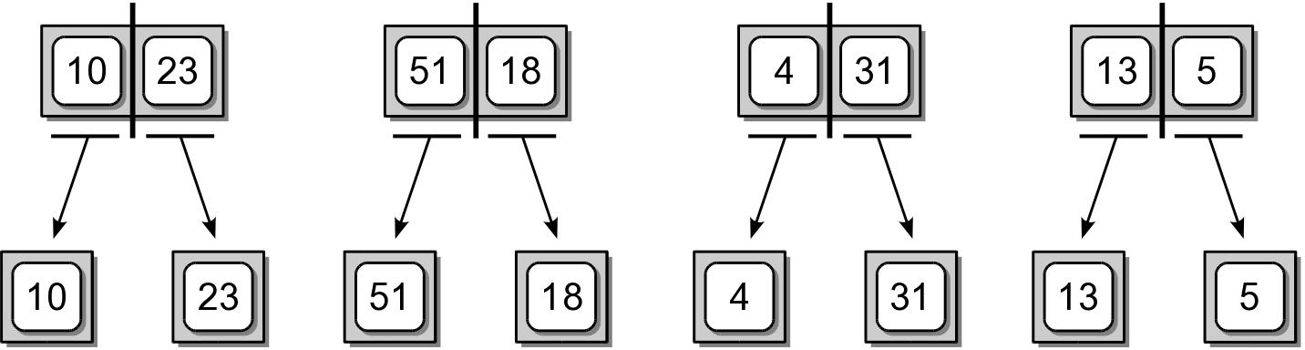
Merge Sort – Divide
The subdivision continues until there is a single item in the sequence.

Slide 10
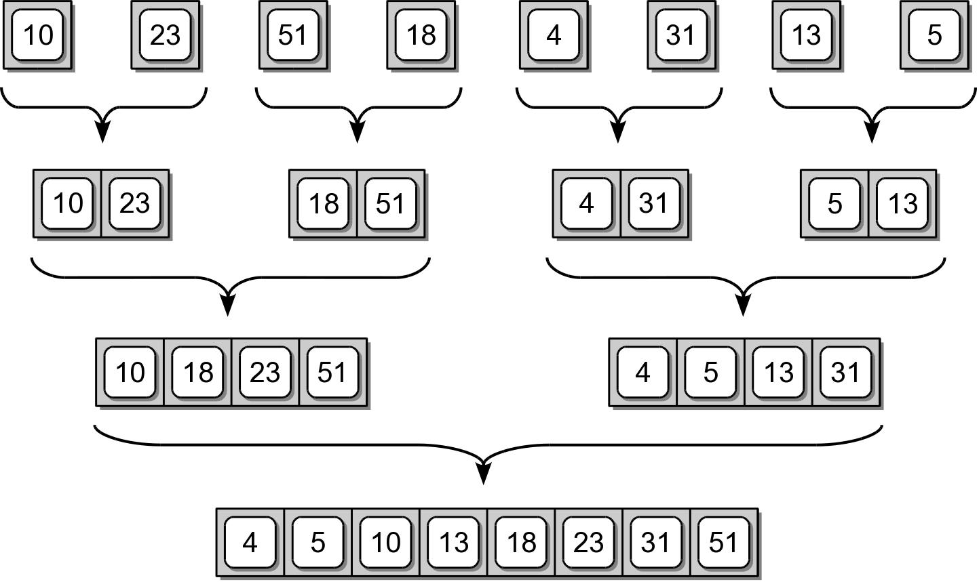
Merge Sort – Conquer
After the sequences are split, they are merge back together, two at a time to create sorted sequences.

Slide 11
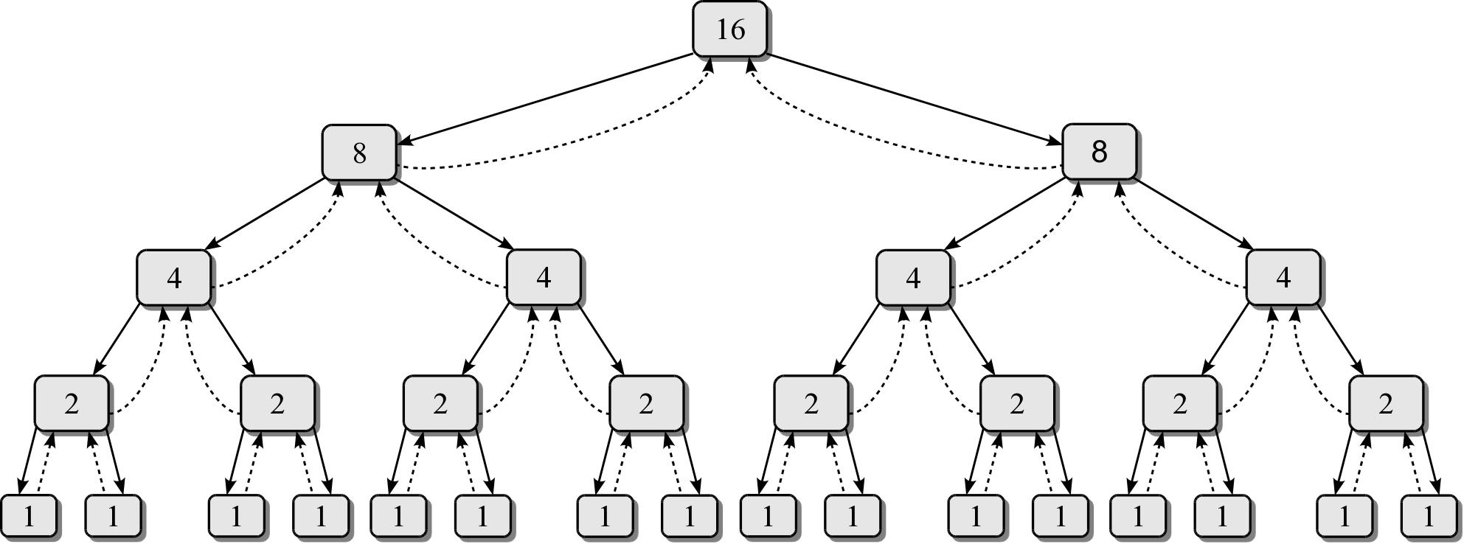
Merge Sort – Efficiency
We need to determine the number of invocations and the time required by each function.

Slide 12
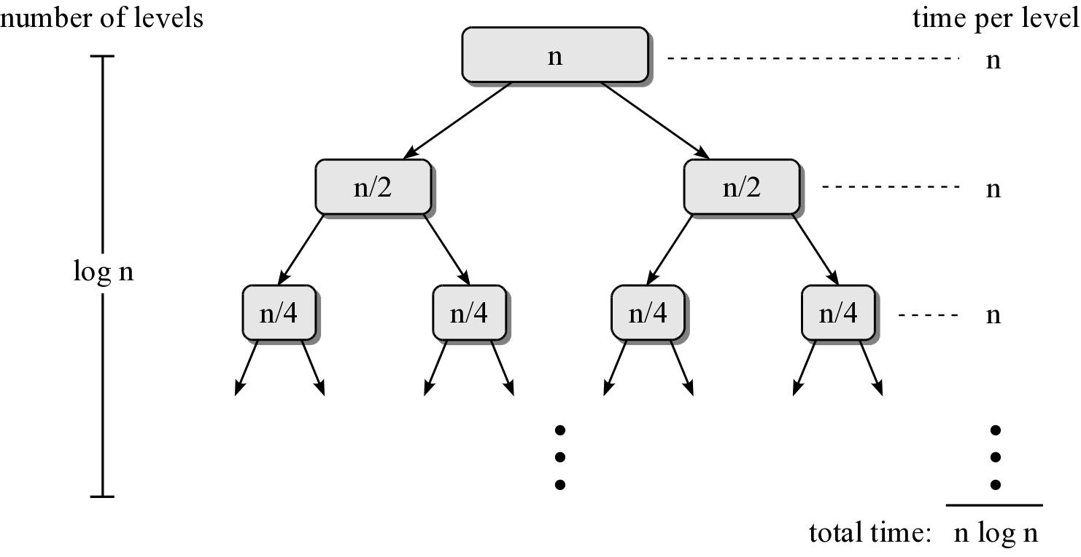
Merge Sort – Efficiency
Consider a sequence of n items.

Slide 13
Quick Sort
Uses a divide and conquer strategy to sort the keys stored in a sequence.
  Partitions the sequence by dividing it into two segments based on a pivot key.
  Uses virtual subsequences without the need for temporary storage.
Quick sort is a recursive algorithm.

Slide 14
Quick Sort – Description
Select the first key as the pivot (p)
Partition the sequence into segments L and G.
  L contains all keys less than p
  G contains all keys greater than or equal to p.
Recursively apply the same operation on L & G.
  Continues until the sequence contains 0 or 1 key.
Merge the pivot and two segments back together.

Slide 15
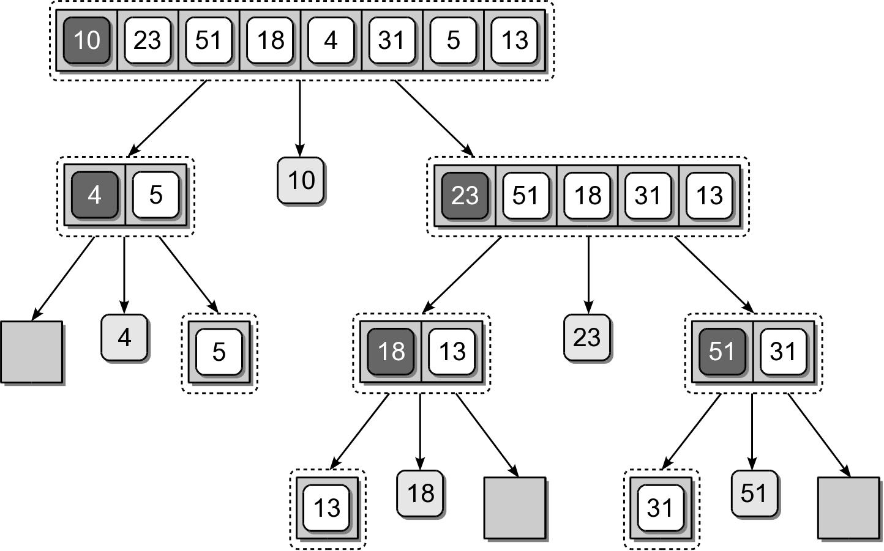
Quick Sort – Divide

Slide 16
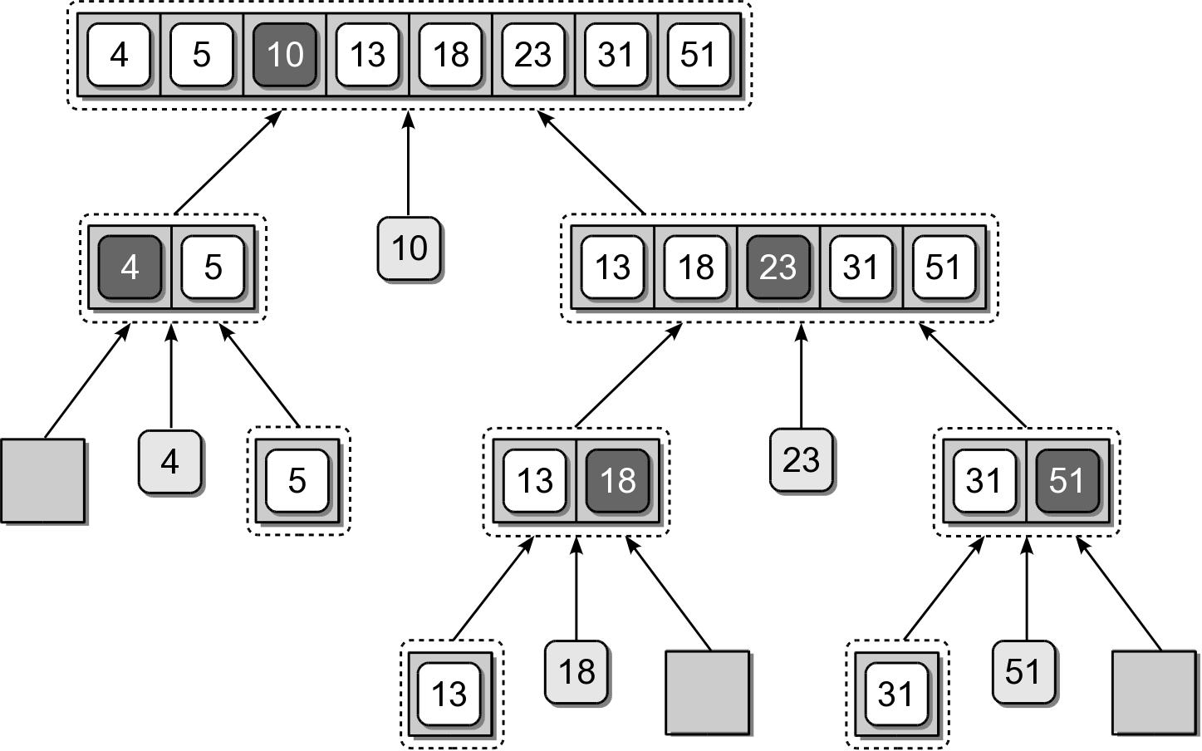
Quick Sort – Merge

Slide 17
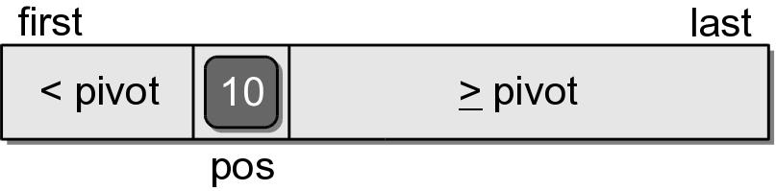
Quick Sort – Partition
The partitioning step can be done without having to use temporary storage.
  Rearranges the keys within the sequence structure.
  The pivot will be in its correct position within the sequence.
  Position of the pivot indicates the position where the split occurred.

Slide 18
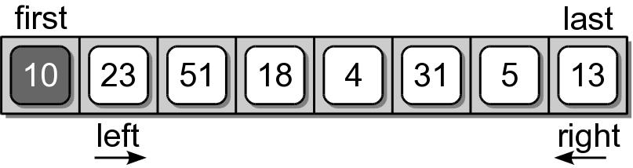
Quick Sort – Partition
For illustration, we step through the first complete partitioning.
  Pivot value is the first key in the segment.
  Two markers (left and right) are initialized.
  The markers will be shifted left and right until they cross each other.

Slide 19
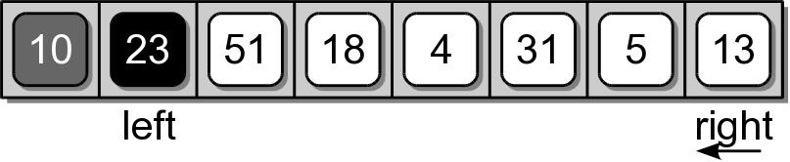
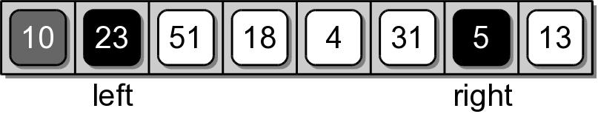
Quick Sort – Partition
The left marker is shifted right until a key value larger than the pivot is found.
The right marker is then shifted left until a key value less than the pivot is found.

Slide 20
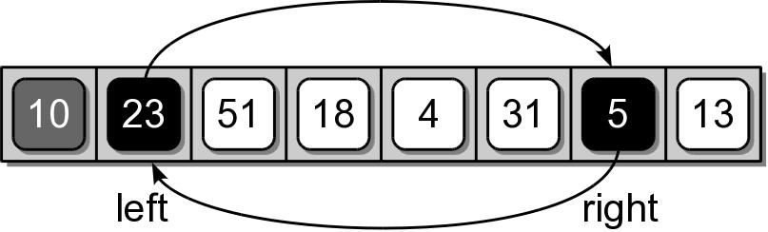
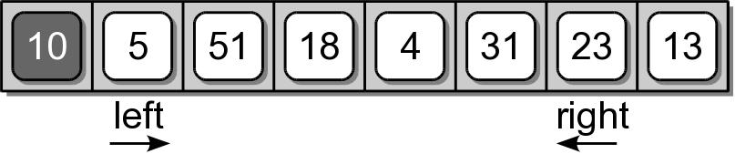
Quick Sort – Partition
The two keys at the positions of the left and right markers are swapped.

Slide 21
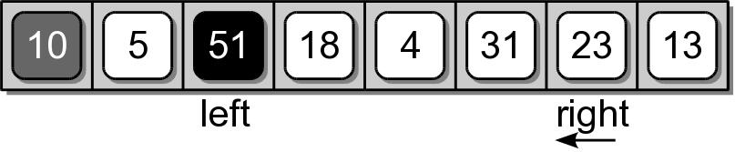
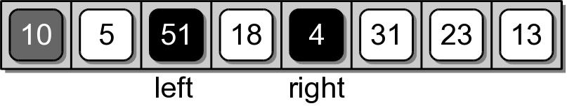
Quick Sort – Partition
The two markers are again shifted starting where they left off.

Slide 22
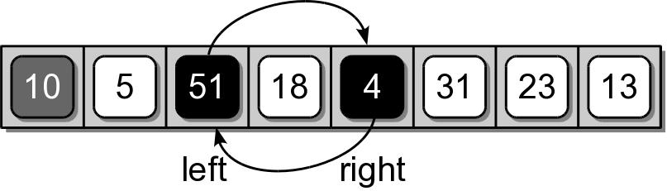
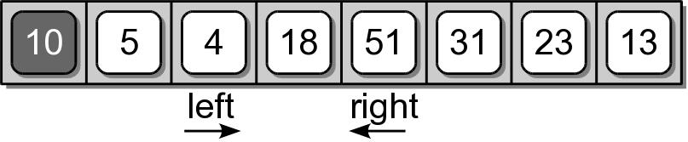
Quick Sort – Partition
After the markers are shifted, the corresponding keys are swapped as before.

Slide 23
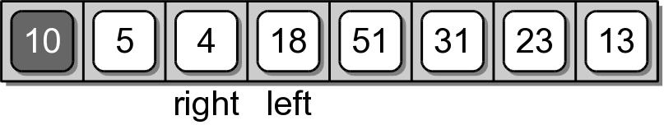
Quick Sort – Partition
The shifting and swapping continues until the two markers cross each other.

Slide 24
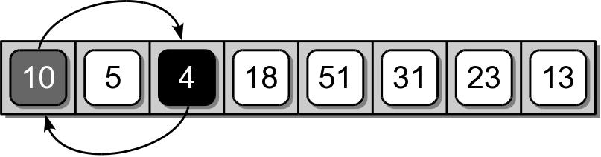
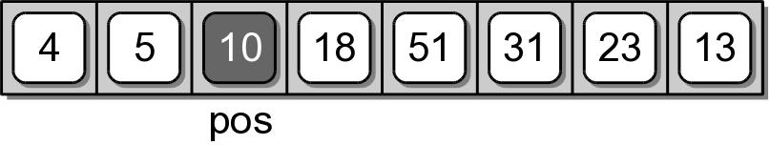
Quick Sort – Partition
When the two markers cross, the right marker indicates the final position of the pivot value.
  The pivot value and the value at the right marker have to be swapped.

Slide 25
Quick Sort – Partition
def partitionSeq( theSeq, first, last ):
pivot = theSeq[first]
left = first + 1
right = last
while left <= right :
while left < right and theSeq[left] < pivot :
left += 1
while right >= left and theSeq[right] >= pivot :
right -= 1
if left < right :
tmp = theSeq[left]
theSeq[left] = theSeq[right]
theSeq[right] = tmp
if right != first :
theSeq[first] = theSeq[right]
theSeq[right] = pivot
return right

Slide 26
Pivot Key
We are not limited to selecting the first key within the sequence as the pivot.
  Using the first or last key is a poor choice in practice.
  Choosing a key near the middle is a better choice.

Slide 27
Quick Sort – Efficiency
The quick sort algorithm:
  has a worst case time of O(n²)
  but an average case time of O(n log n)
It does not require additional storage.
Commonly used in language libraries.
  Earlier versions of Python used quick sort.
  Current versions use a hybrid that combines the insertion and merge sort algorithms.

Slide 28
How Fast Can We Sort?
Algorithm | Worst Case Time
Bubble | O(n²)
Selection | O(n²)
Insertion | O(n²)
Merge | O(n log n)
Quick | O(n²)

Slide 29
Sorting Algorithms
Can be divided into two categories:
  comparison sorts
    items are arranged by performing pairwise logical comparisons between two sort keys.
  distribution sorts
    distributes the sort keys into intermediate groups based on individual key values.

Slide 30
Radix Sort
A fast distribution sorting algorithm.
  Special purpose sorting algorithm.
  Orders keys by examining individual key components instead of comparing them.
  When used with integers, individual key digits are compared from least to most significant.
  aka bin sort
    dates back to the days of card readers.

Slide 31
Radix Sort Example
Bins are used to store various keys based on individual column values.
  Consider an array of positive integers.
  We will need 10 bins, one for each digit.

Slide 32
Distribute the Keys
The process starts by distributing the keys among the various bins.
  Based on the digits in the ones column.
  Stored in the order they occur in the sequence.

Slide 33
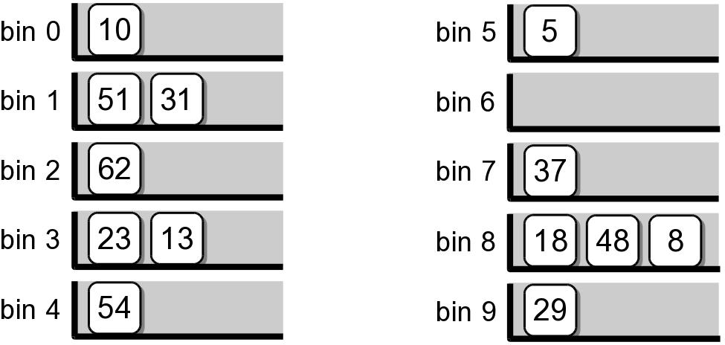

Slide 34
Gather the Keys
The keys are then gathered back into the array, one bin at a time.
  Start with bin 0 and continue in bin order.
  Gathered without rearranging.

Slide 36
Repeat the Process
Repeat the process, but this time based on the 10's column.

Slide 37
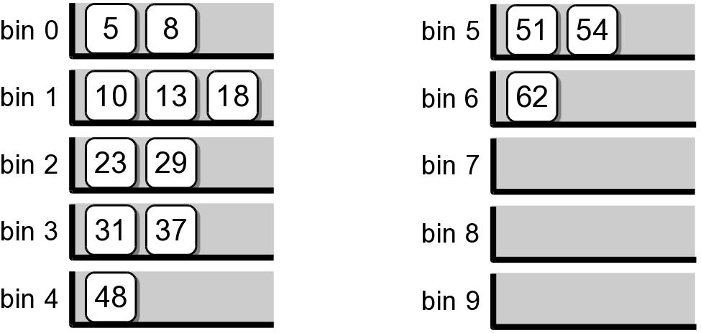

Slide 39
Radix Sort – Iterations
The iterative process has to be repeated for the number of digits in the largest value.

Slide 40
Radix Sort – Implementation
How should we represent the storage bins?
  The bins store groups of keys based on the individual digits.
  Keys with duplicate digits are stored in FIFO in the same bin.
  When gathered, the keys are stored back into the original sequence structure.

Slide 41
Radix Sort – Implementation
How do we compare individual integer digits?
  where column is the value (1, 10, 100, ...) of the column being processed.
digit = (key // column) % 10

Slide 42
Radix Sort – Analysis
Assume:
  a sequence of n keys
  each key consists of d components
  each component contains a value between 0 and k.
  use of the linked list version of the Queue ADT.

Slide 43
Radix Sort – Analysis
The creation of the array and queues: O(k)
The distribution and gathering: O(dn)
  distribute the n keys across k bins: O(n)
  gathering the n keys back into the sequence: O(n)
Total time: O(k + dn)
  In practice, k and d are constants.
  When sorting integers, the time only depends on the number of keys: O(n)

Slide 44
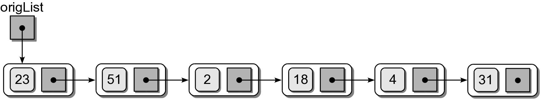
Sorting Linked List
What if we need to sort keys stored in an unsorted linked list?
  Many of the algorithms used with sequences can be used.
  Instead of swapping values, nodes are unlinked and relinked as necessary.

Slide 45
Insertion Sort – Linked List
A simple approach for sorting a linked list:
  unlink each node, one at a time, from the original unsorted linked list
  insert each node into a new sorted linked list.
def llistInsertionSort( origList ):
if origList is None :
return None
newList = None
while origList is not None :
curNode = origList
origList = origList.next
curNode.next = None
newList = addToSortedList( newList, curNode )
return newList

Slide 46
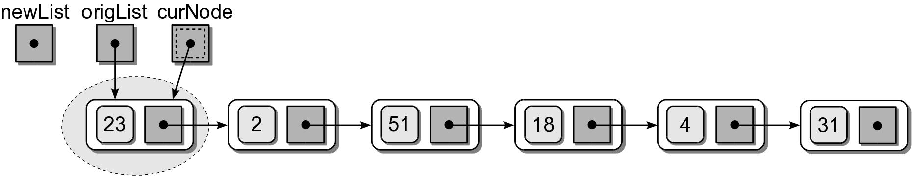
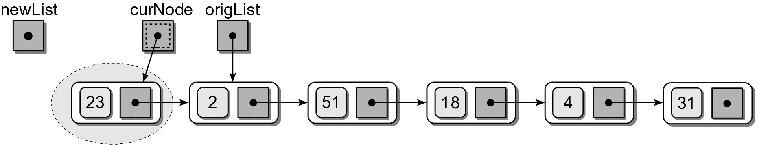
Insertion Sort – Linked List
The unlinking/relinking is done in 4 steps:

Slide 47
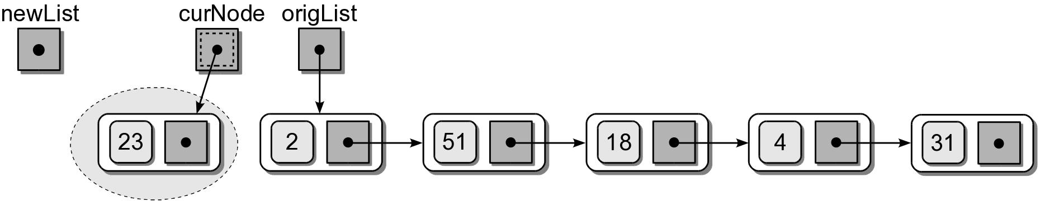
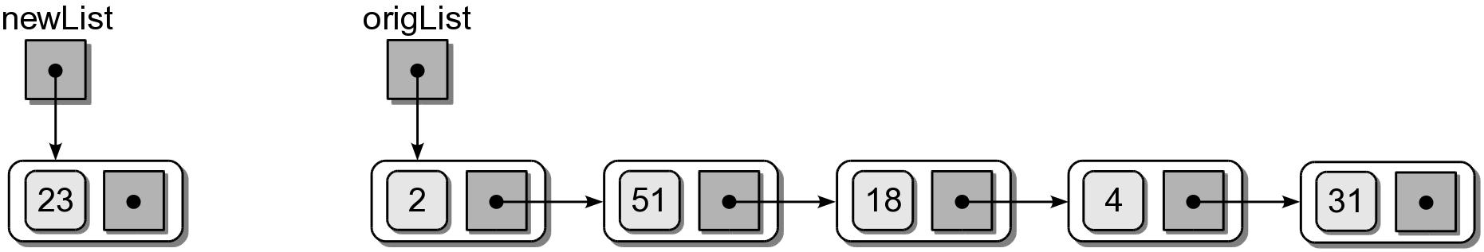
Insertion Sort – Linked List
The unlinking/relinking is done in 4 steps:

Slide 48
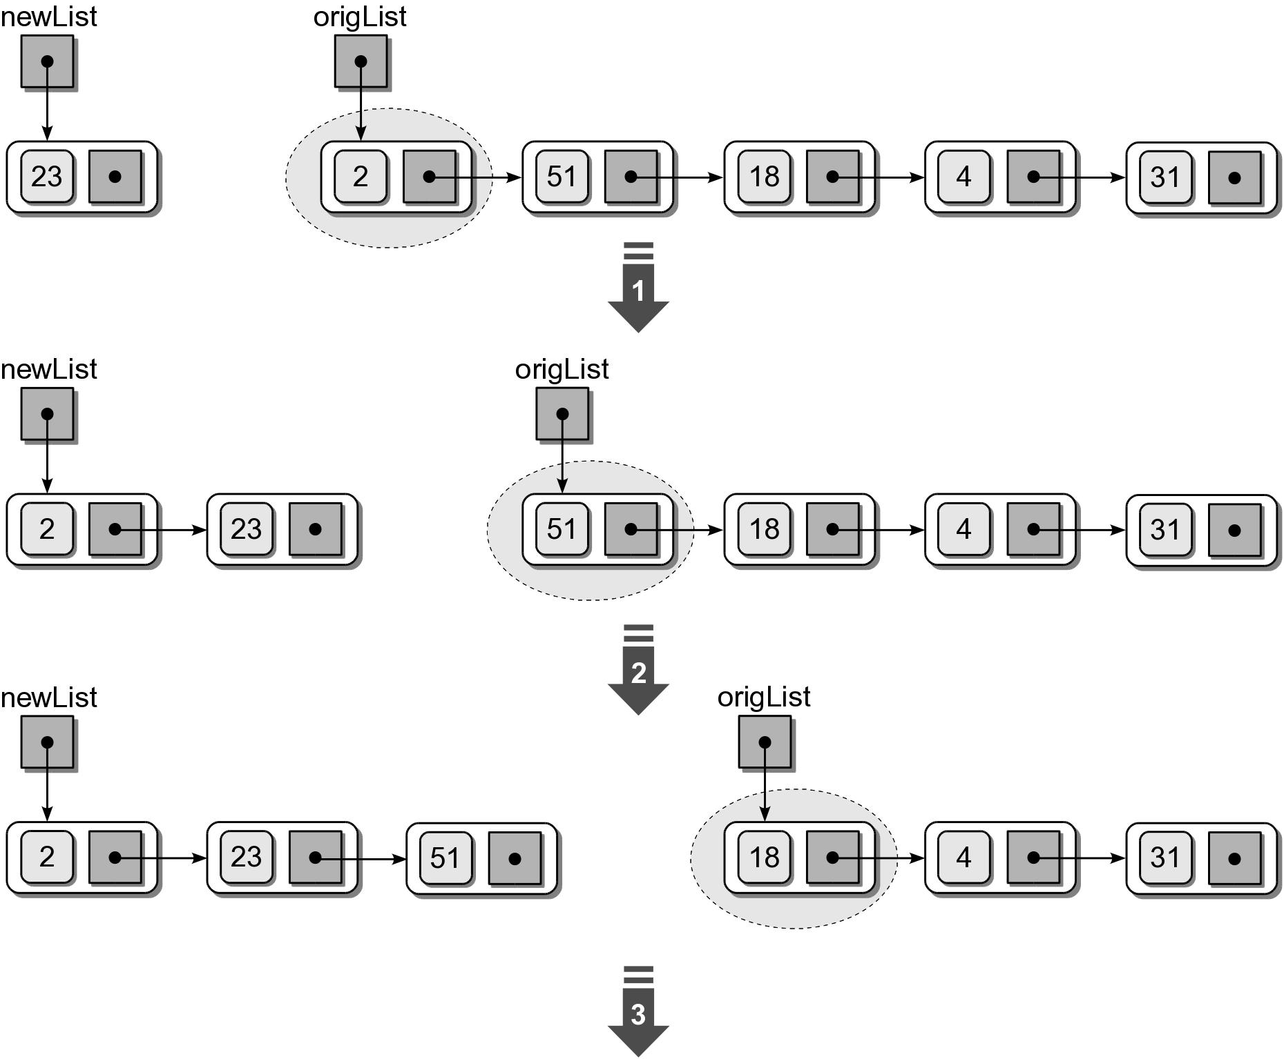
Insertion Sort – Linked List

Slide 49
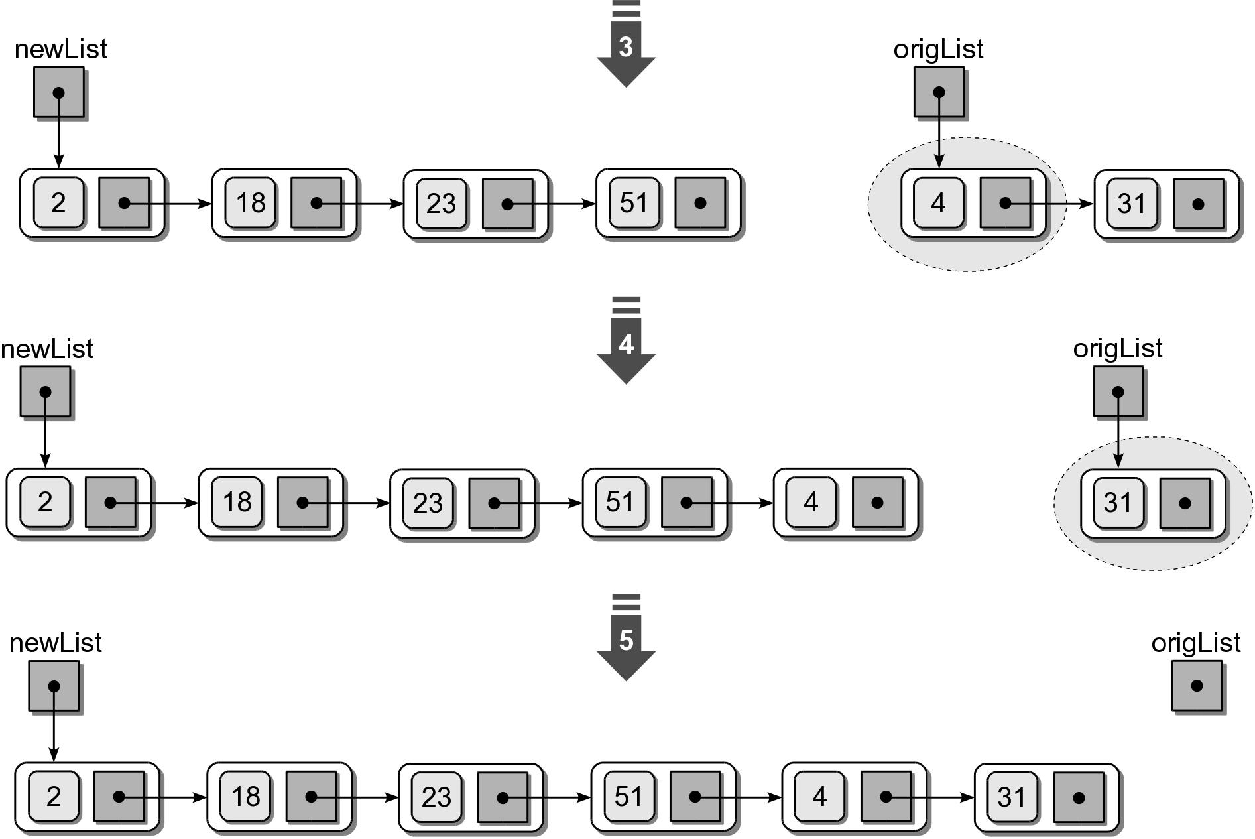
Insertion Sort – Linked List

Slide 50
Merge Sort – Linked List
Is an excellent choice for sorting a linked list.
  No additional storage space is needed.
  Efficient in both time and space.

Slide 51
Merge Sort – Linked List
To split a linked list the node located at the midpoint.
  Can not directly access this node.
  Must traverse the list to find the midpoint.
  Use two temporary external references.
    Advance one reference, one node at a time.
    Advance the other, two nodes at a time.
  Done when the latter falls off the list.

Slide 52
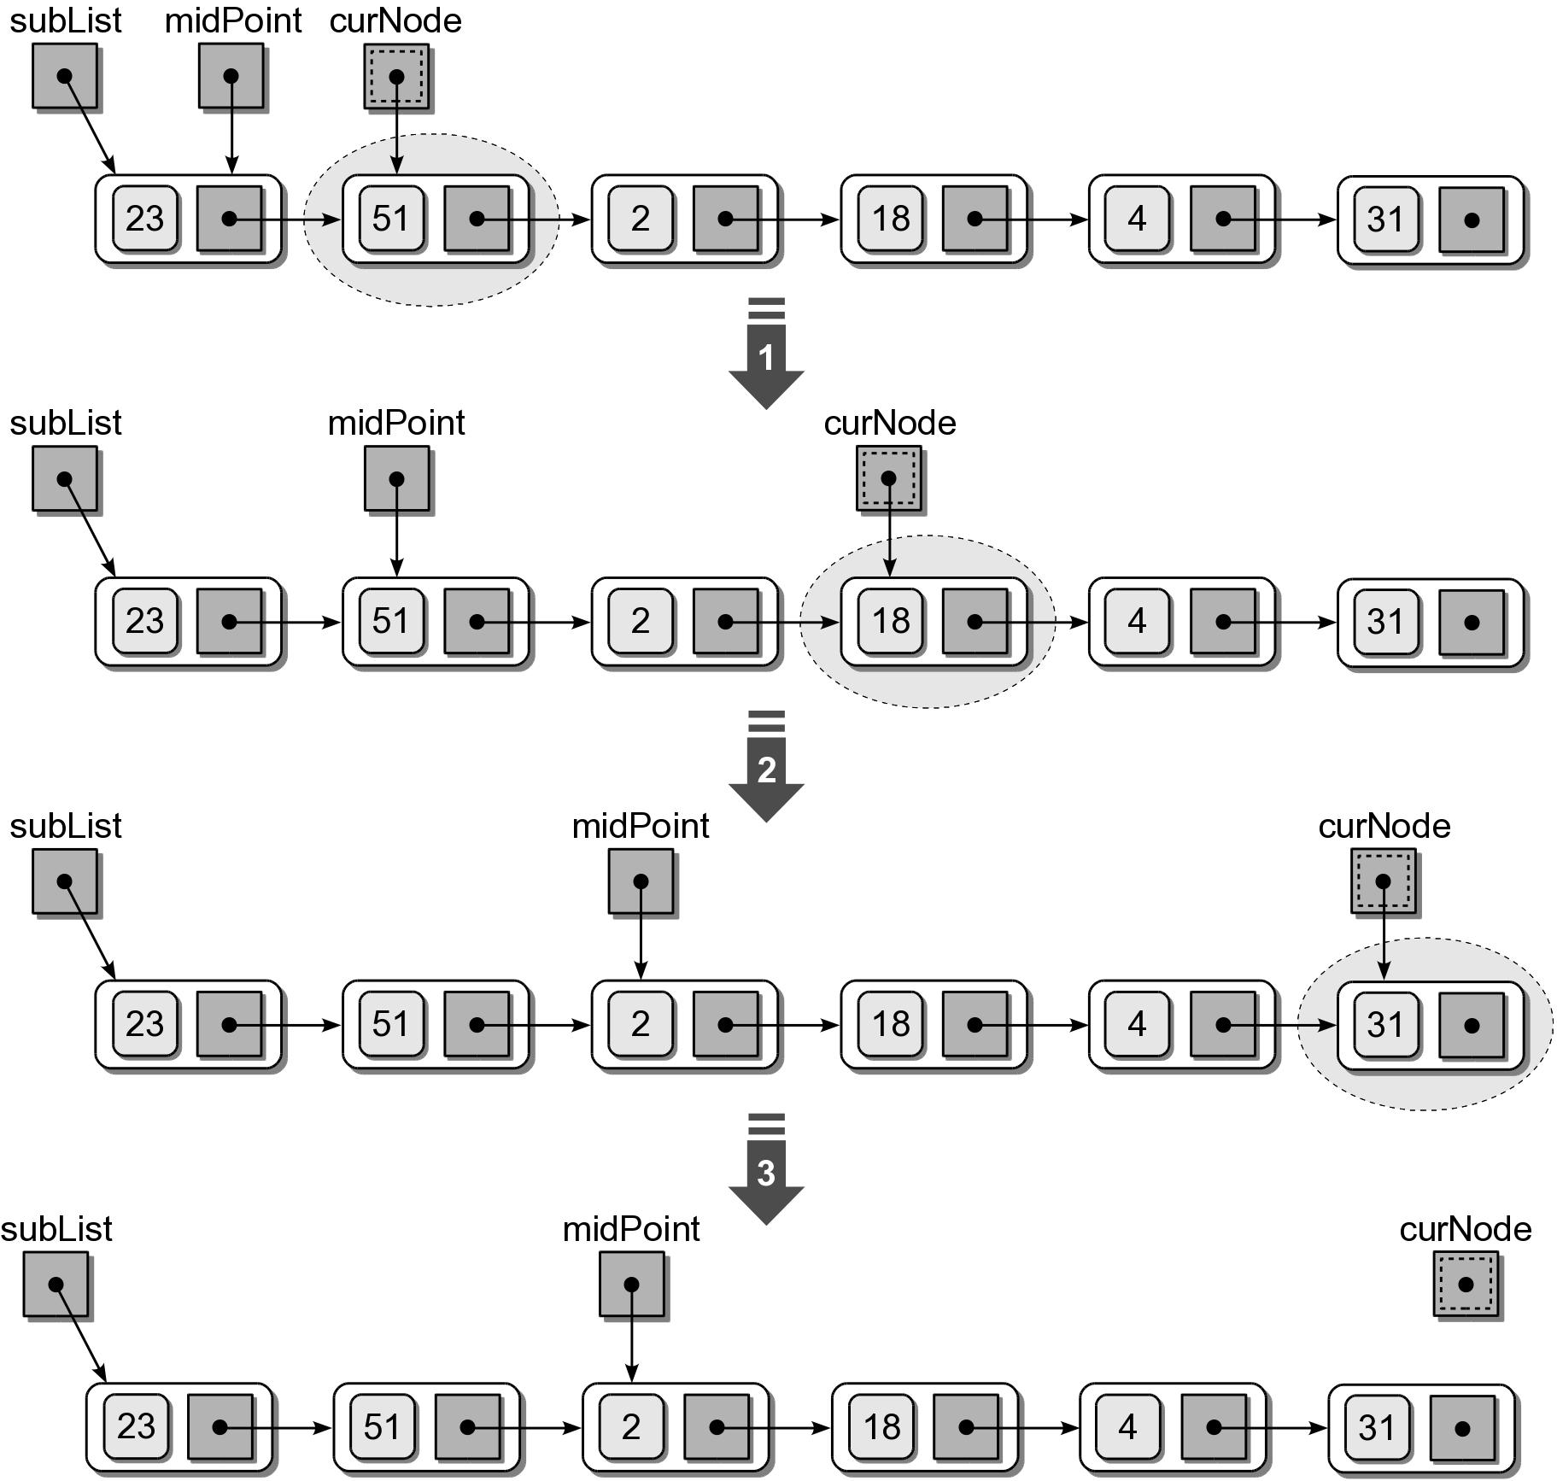
Merge Sort – Linked List

Slide 53
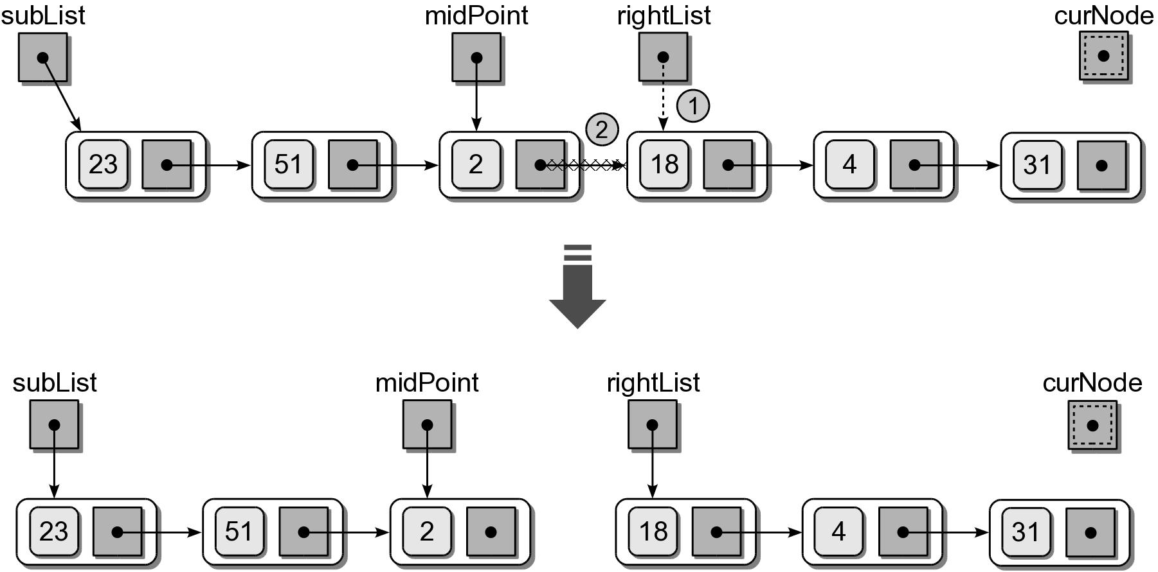
Merge Sort – Linked List
After the midpoint is located, remove the link between to two sublists.

Slide 54
Merge Sort – Linked List
Merging the two sub linked list can be done in a similar fashion as that used with sequences.
  Remove each node from the unsorted lists.
  Insert them into a new sorted linked list.
  Use a tail reference with the new list.

